Slide 1

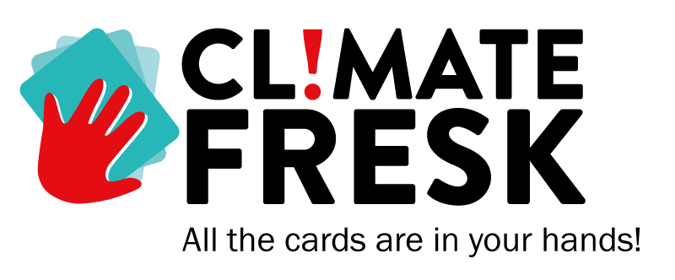



Slide 2
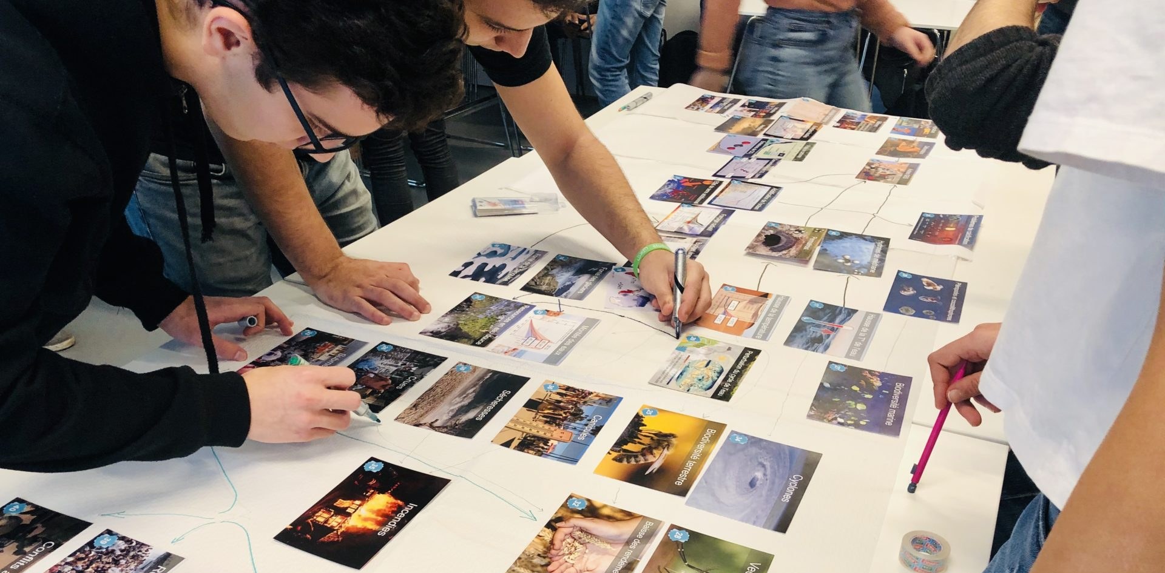




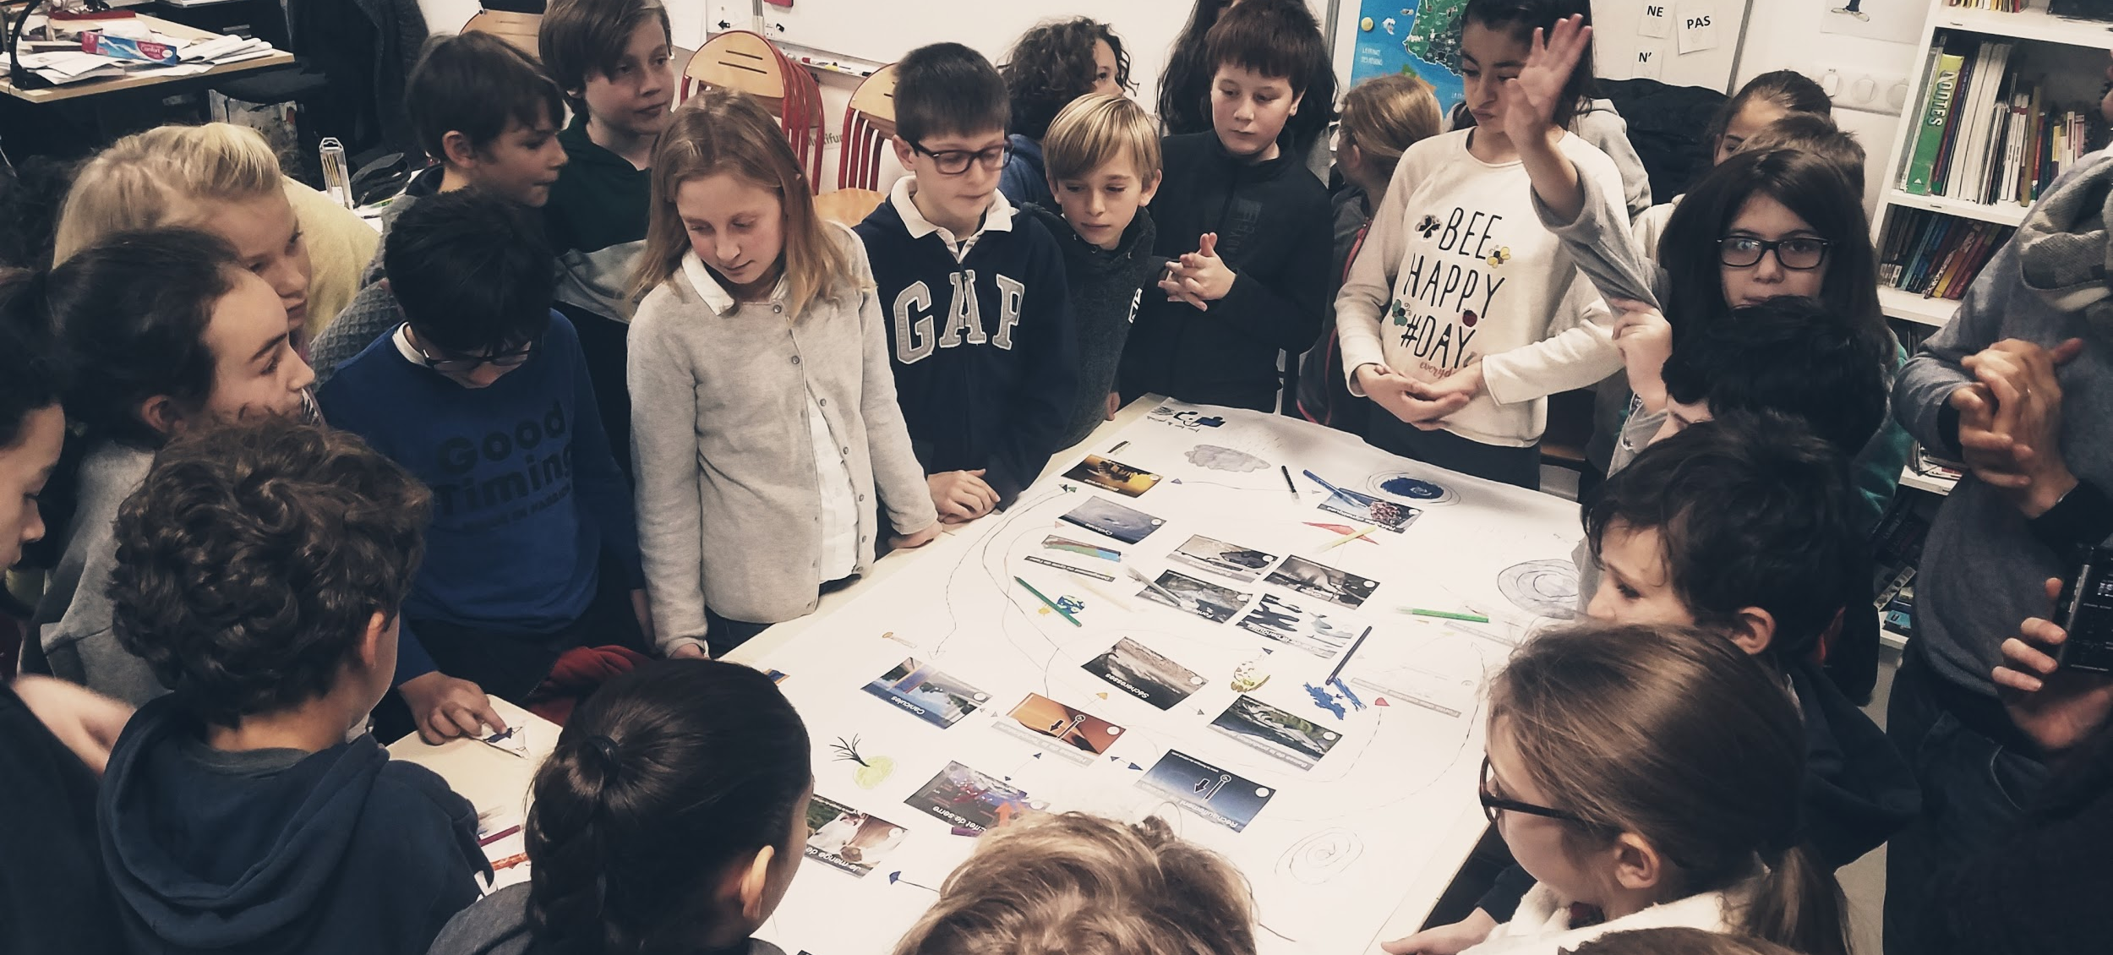





THE CLIMATE FRESK – WHAT IS IT ?
A scientific workshop, based on the IPCC report designed to raise awareness about climate change
A deck of 42 cards, each representing in a systemic way a component of climate change
Creates cohesion through collective intelligence methodology
Collaborative, creative and fun
Generates the desire to act and engage participants in a proactive approach
Higher education: 3h
Secondary school: 2h-3h
Groups of 4 to 7 participants
1 facilitator per 2 groups
or 14 participants

Slide 3
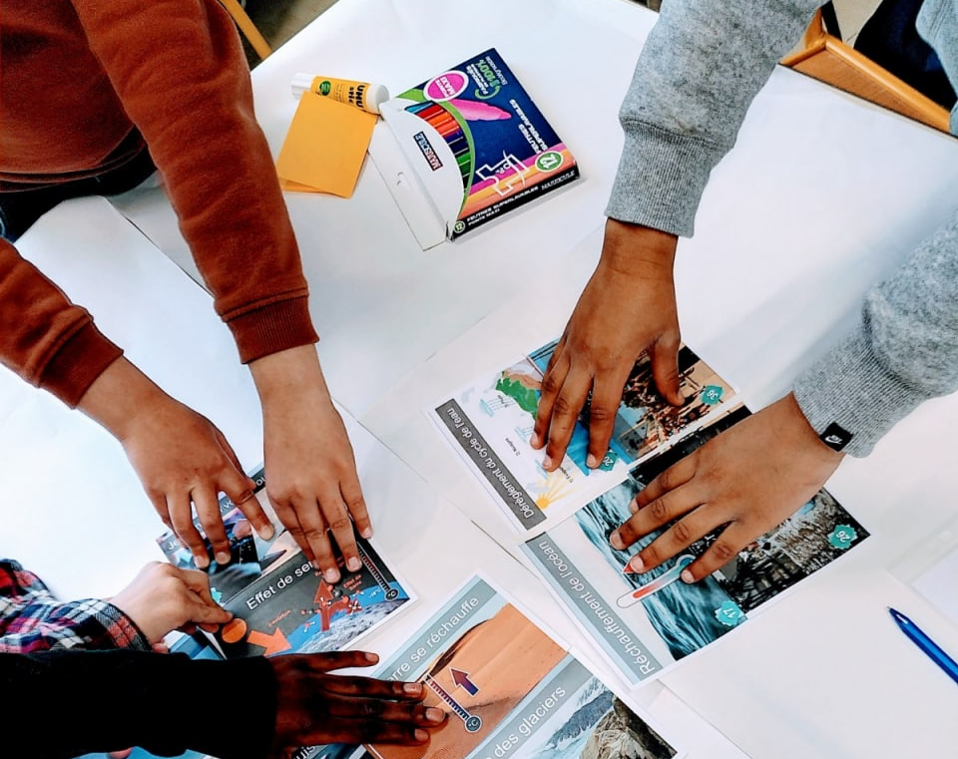
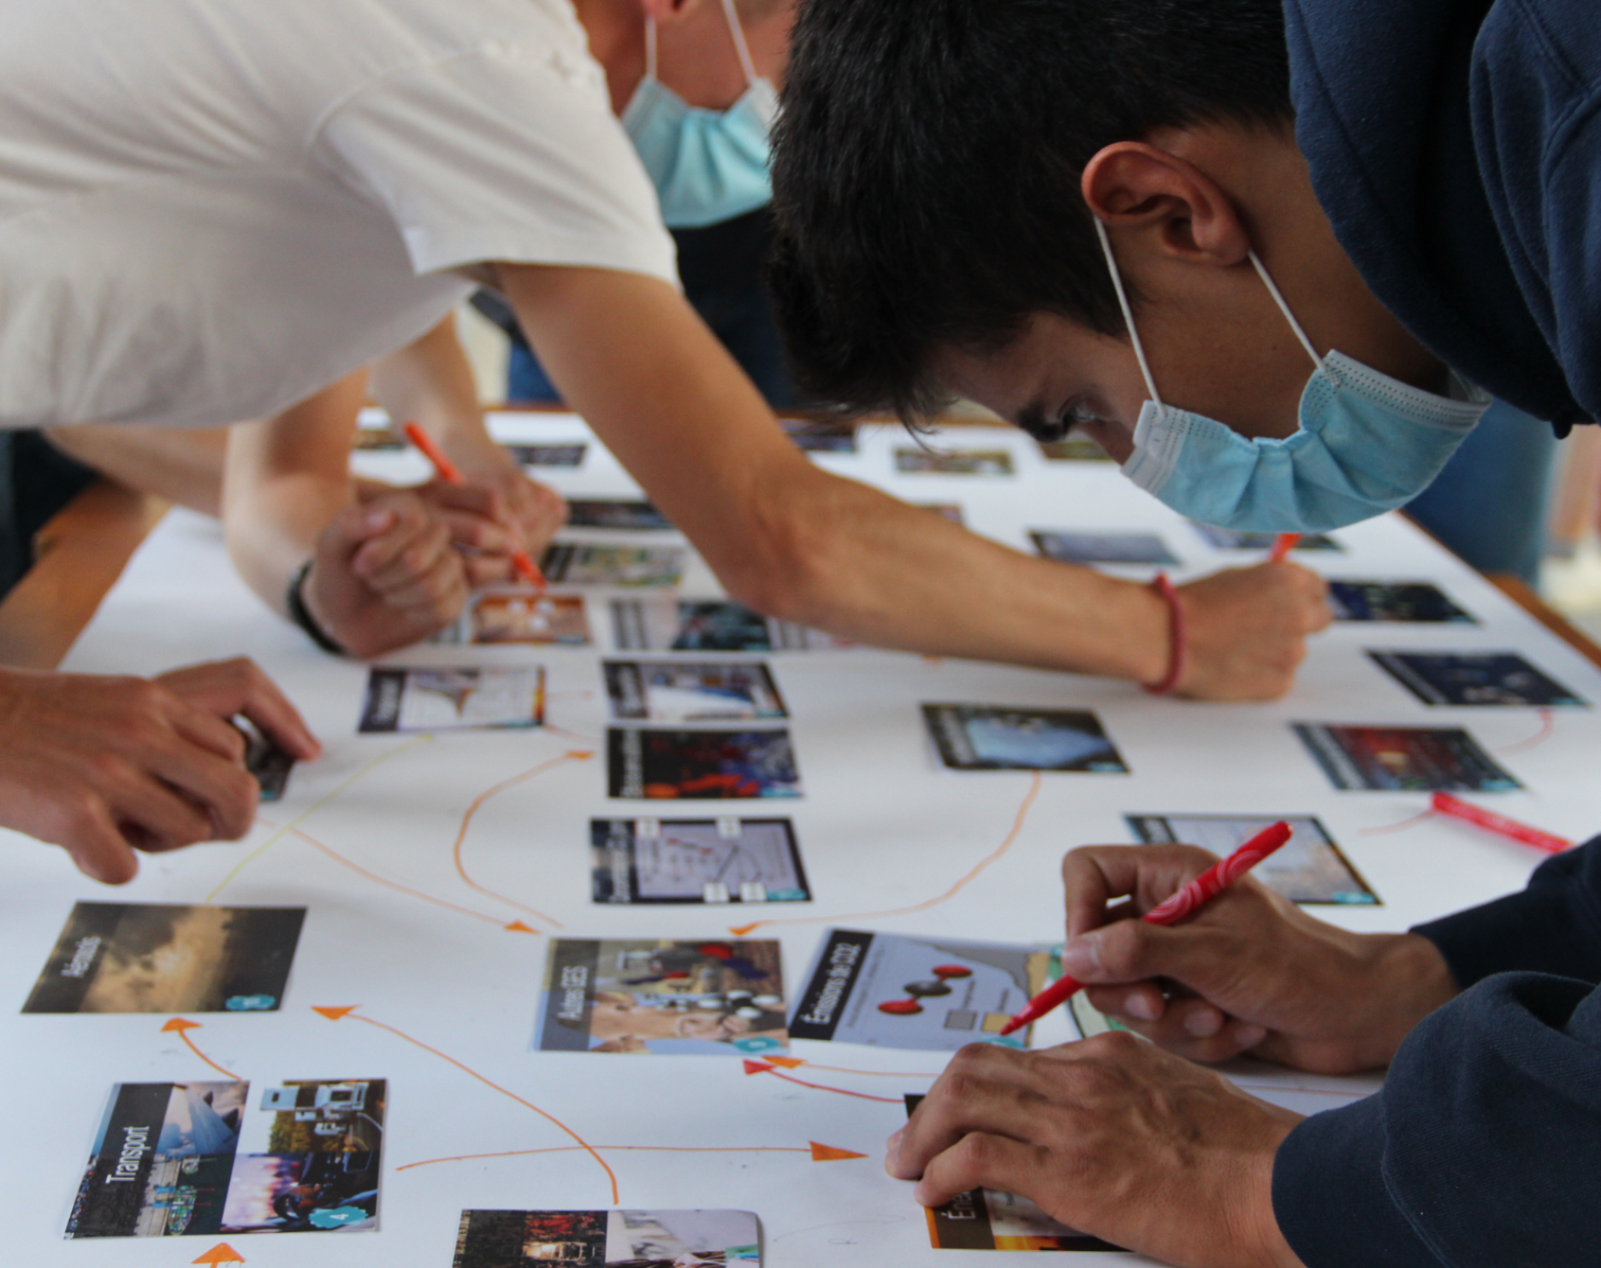
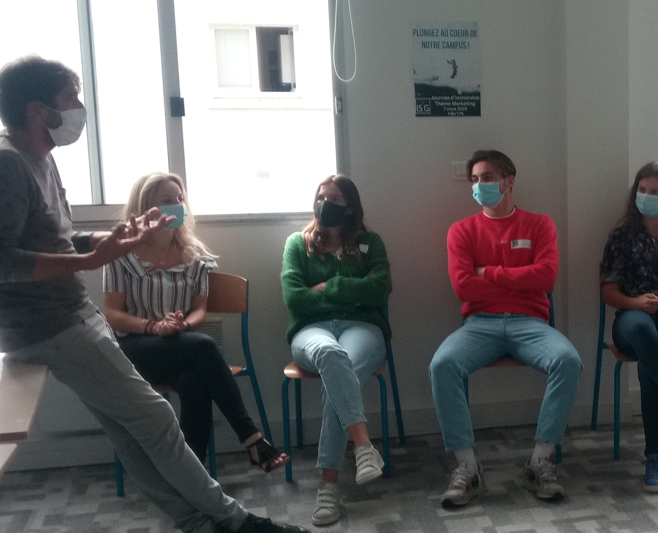
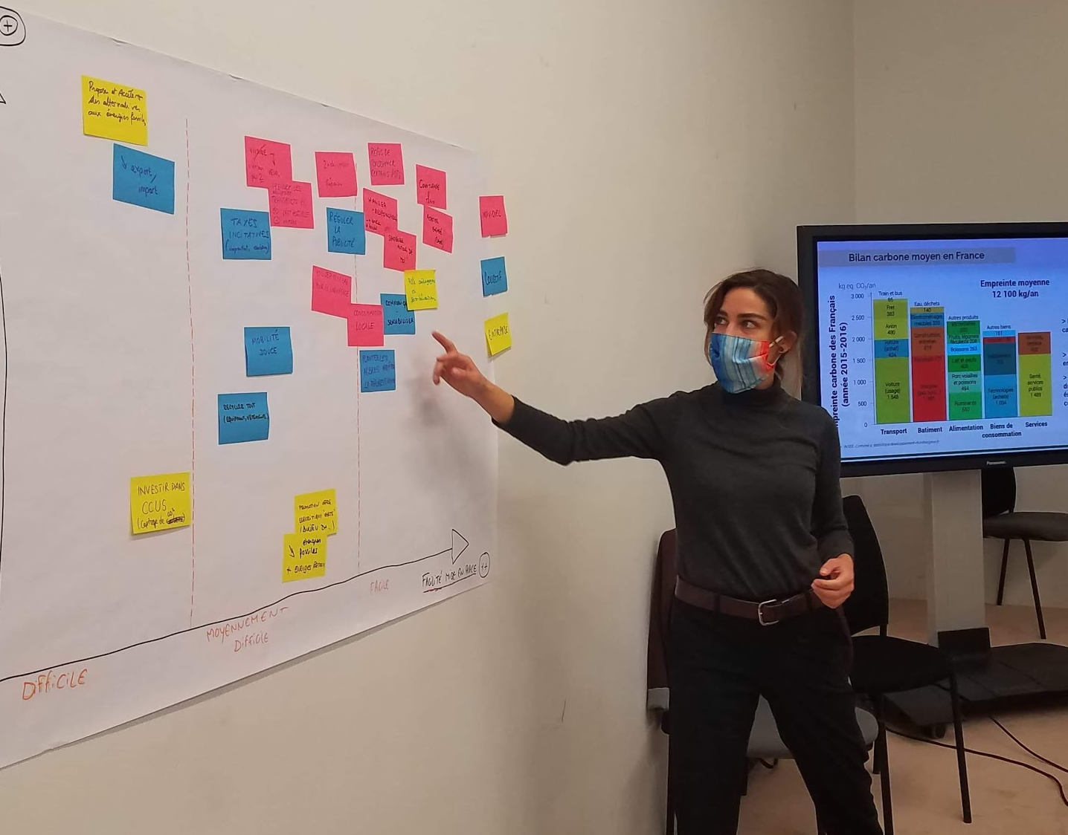


THE CLIMATE FRESK - THE PHASES OF THE WORKSHOP
PHASE 1
BUILD AND LINK THE CARDS
PHASE 2
CREATIVITY, EXPRESSION, COHESION
PHASE 3
PRESENT THE FRESK AND SHARE YOUR EMOTIONS
PHASE 4
DEBRIEFING AND TAKING ACTION
Understand the problem
Anchor knowledges
Consolidate knowledges and welcome emotions
Project towards action
SAME PHASES IN CASE OF AN ONLINE WORKSHOP
0h50 10-14 yo
1h30 14+ yo
0h10 10-14 yo
0h20 14+ yo
0h30 10-14 yo
0h40 14+ yo
0h30

Slide 4




THE CLIMATE FRESK – KEY FACTS AND NUMBERS
> 1 000 000
> 800
participants
PLAYFUL
CREATIVE
> 45 000
> 50
trained facilitators
COLLABORATIVE
SIMPLE
130+
countries
VISUAL
SCIENTIFIC
45
languages

Slide 5
WHY IS IT SUCH A SUCCESS ?
PLAYFUL
Our workshop is playful, fun and educational.
COLLABORATIVE
The workshop fosters team spirit and collective intelligence.
.
VISUAL
Because a picture is worth a thousand words.
CREATIVE
Time to be creative! Make your Collage unique: give it a title, add drawings etc.
SIMPLE
You only need the deck of cards, pens, paper, a table, and you are all set!
SCIENTIFIC
The content is based on the IPCC reports - the most reliable source of climate related data.

