Slide 1
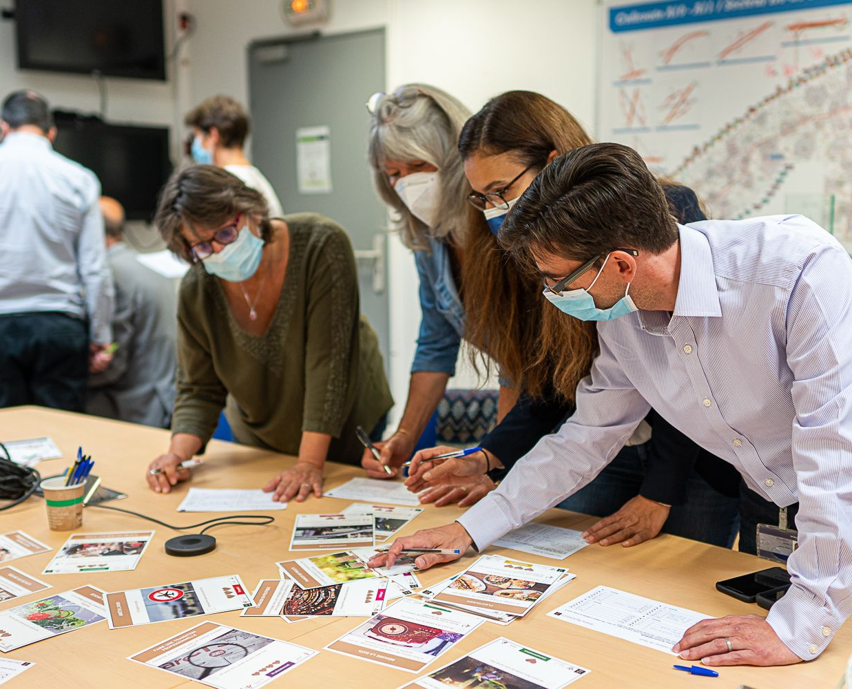


THE IMMERSIVE WORKSHOP
Explore
the future and act together for climate!

Slide 2
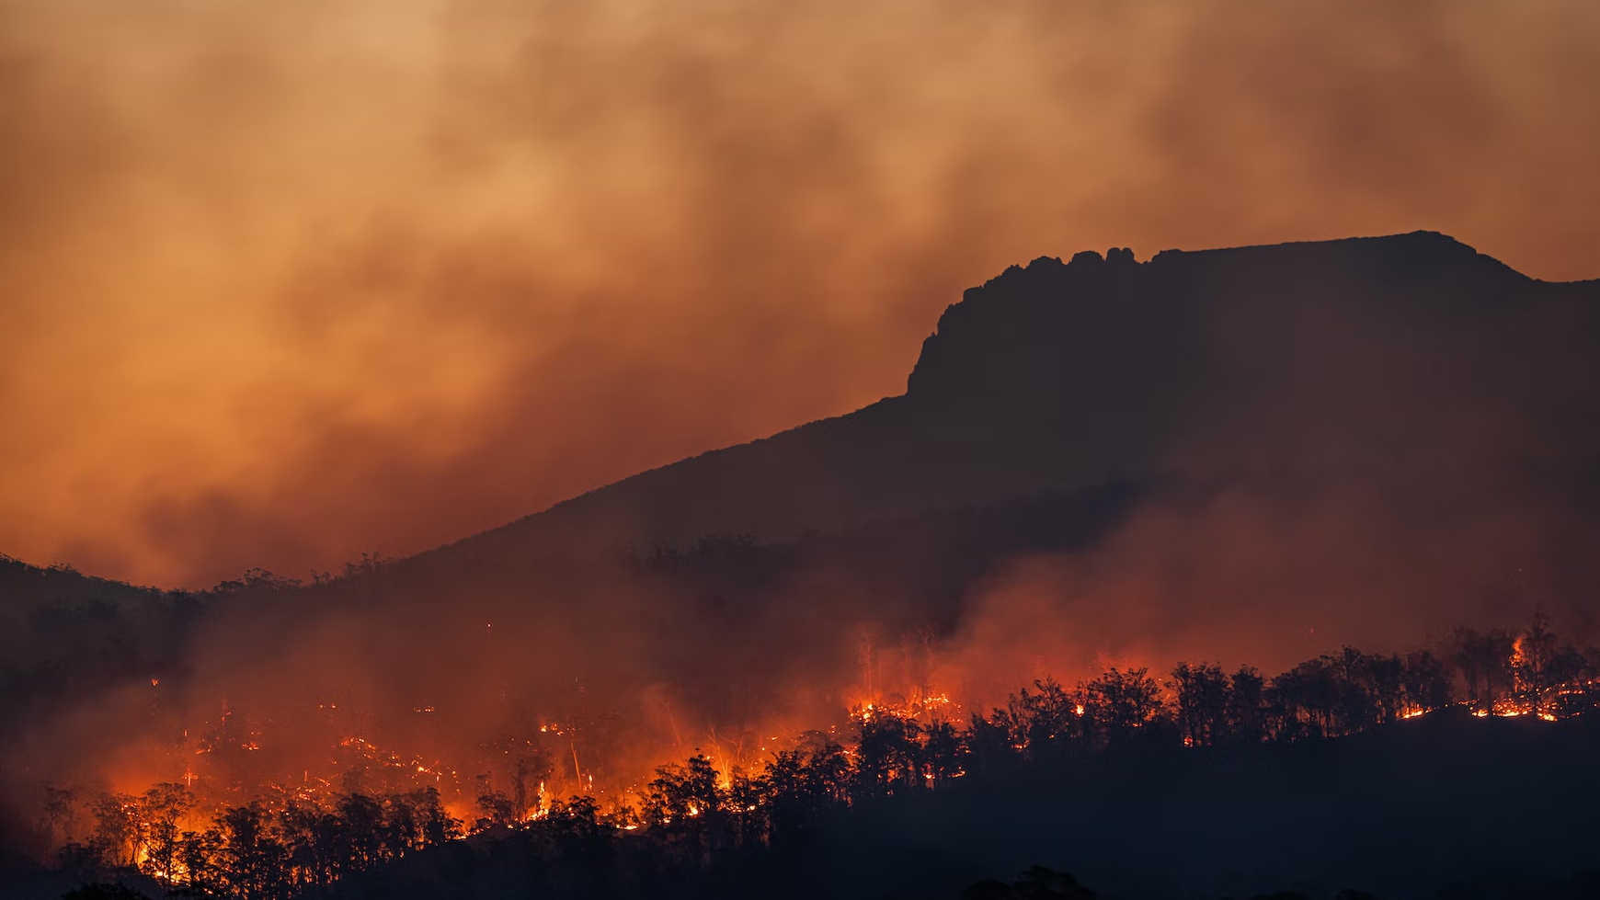

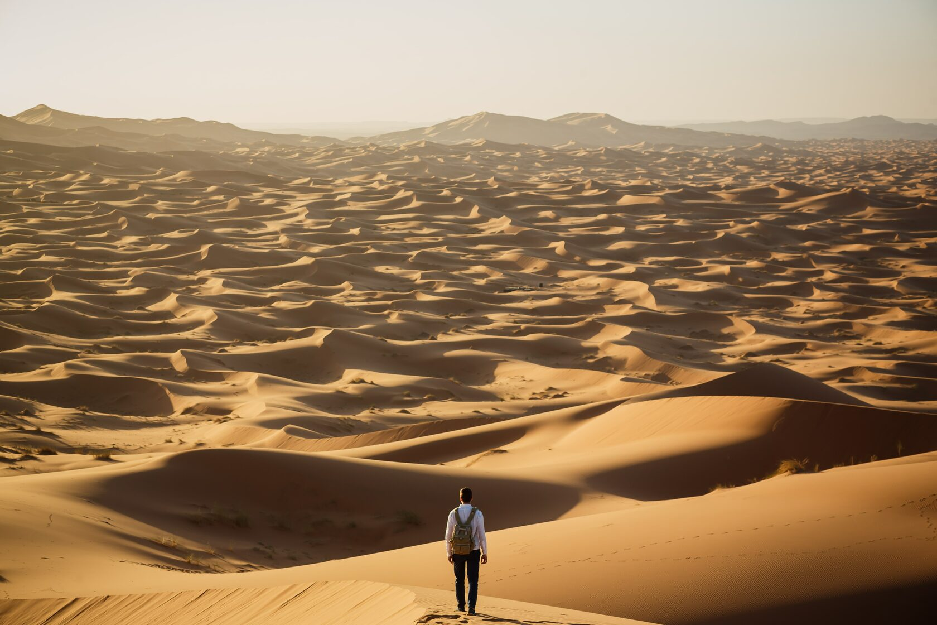

Climate change
is a global issue
Low-carbon transition is urgent,
but we do not act fast enough, why ?
Lost
Discouraged

Slide 3
OUR MISSION
To encourage people to take action and to accelerate the transition
We provide an immersive and playful experience to the participants, with 2 main objectives:ves:
Orders of magnitude
Understand the impact of different sectors, and levers for action.
Positive experience
Realize your power to act, and develop a will to take action, your way!

Slide 4




2tonnes Workshop:
3 hours
Group of 6-15
1 facilitator
Face-to-face or Online

Slide 5



One goal:
2tons !
tCO₂e /person / year
10
8
The purpose of 2tons is to understand the amount of carbon we emit in the atmosphere, individually and collectively, and how we can take action to reduce this carbon footprint.
In 2018, the average carbon footprint of a Japanese citizen was roughly 11tons of CO2eq
Source : https://worldmrio.com/footprints/carbon/
6
4
2
Today
2050

Slide 6
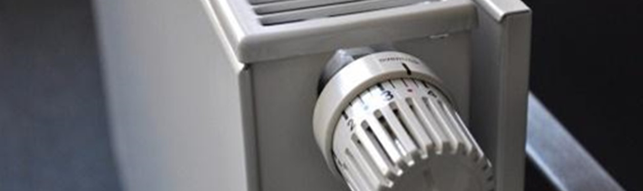
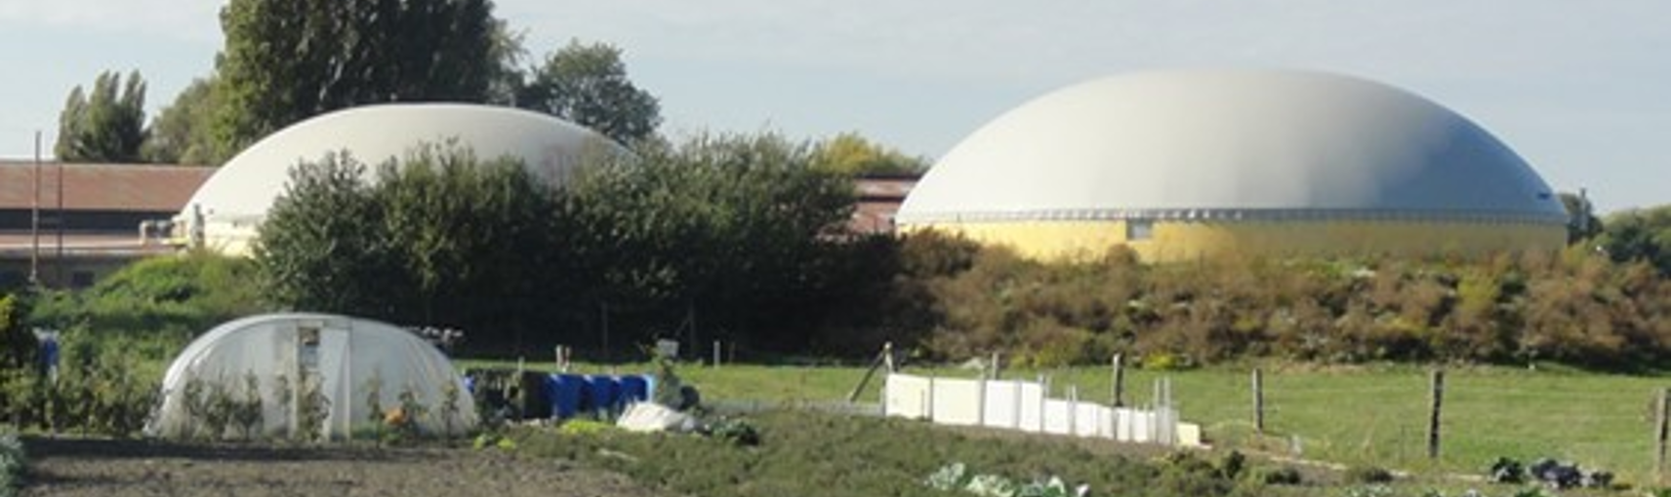
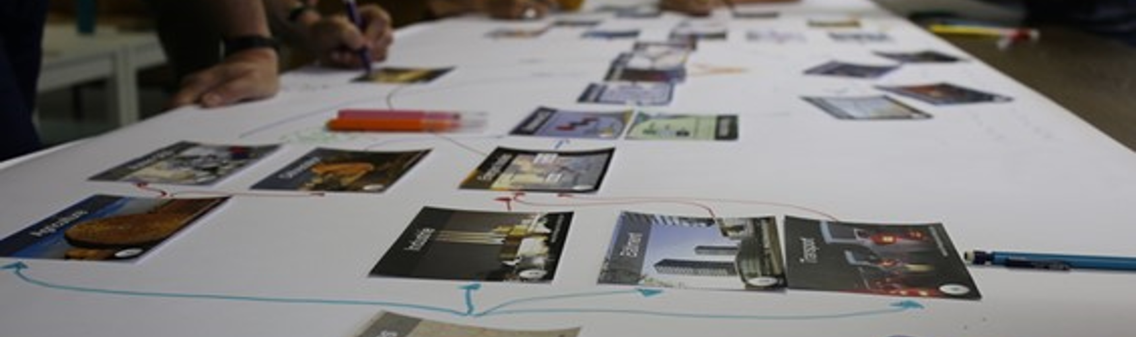
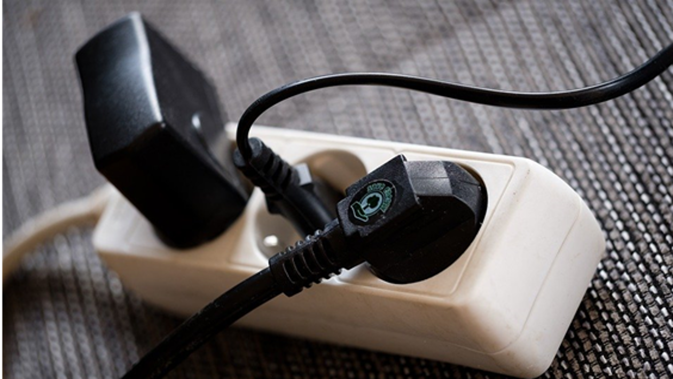
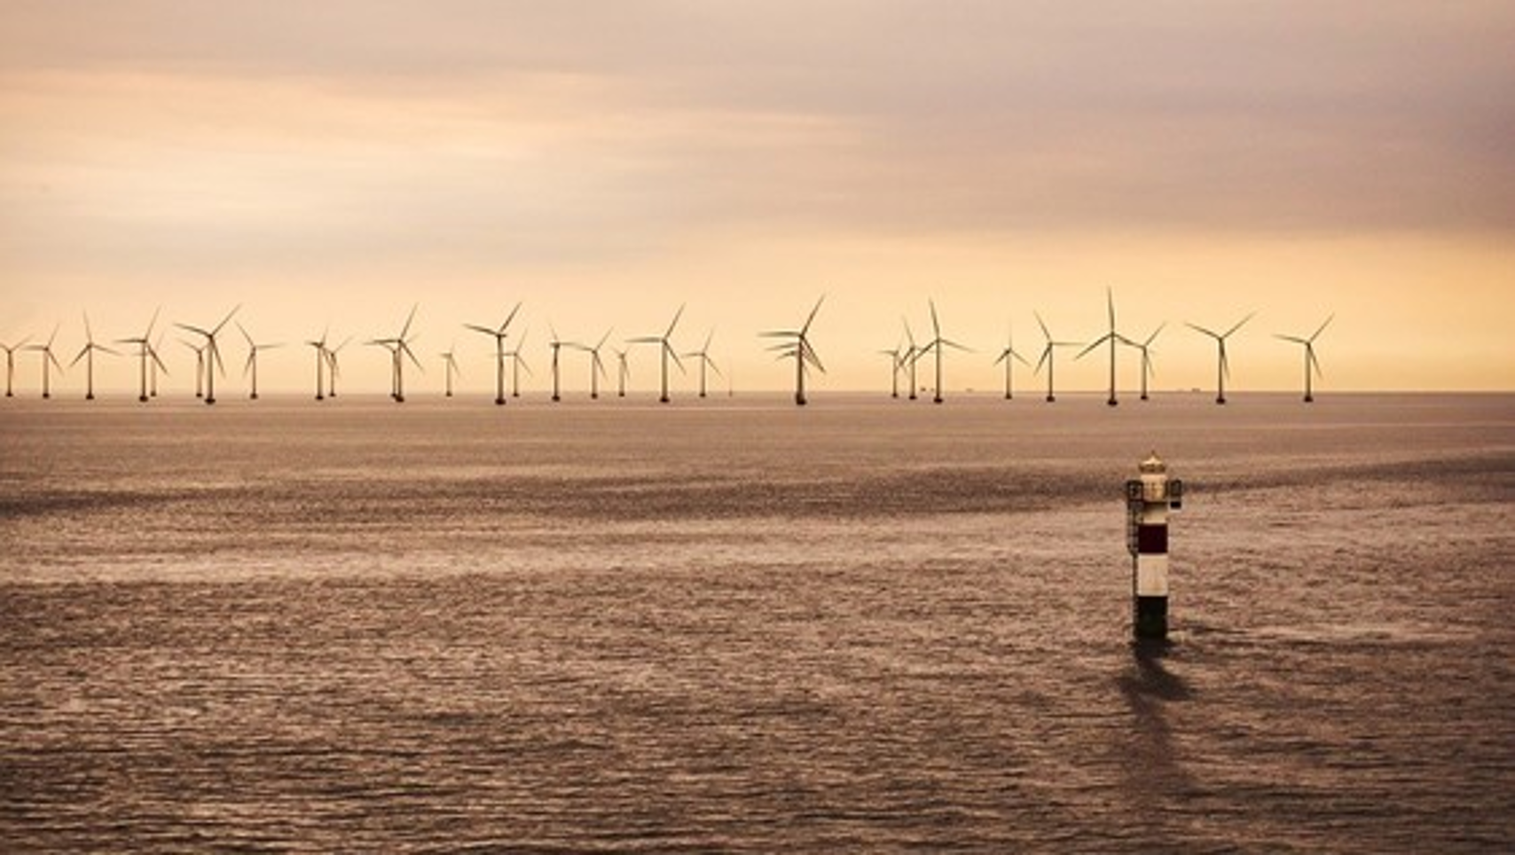
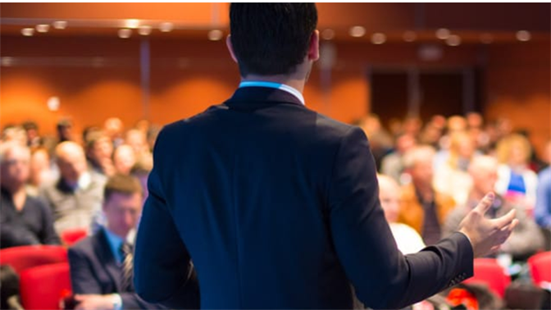
Before
During the workshop
After
1. FOOTPRINT
2. INTRODUCTION
3. SIMULATION
4. DEBRIEFING
5. ACTION !
Individual actions:
Ecogestures
Collective actions:
The role of business and government
Influencing actions:
Tipping point

Slide 7
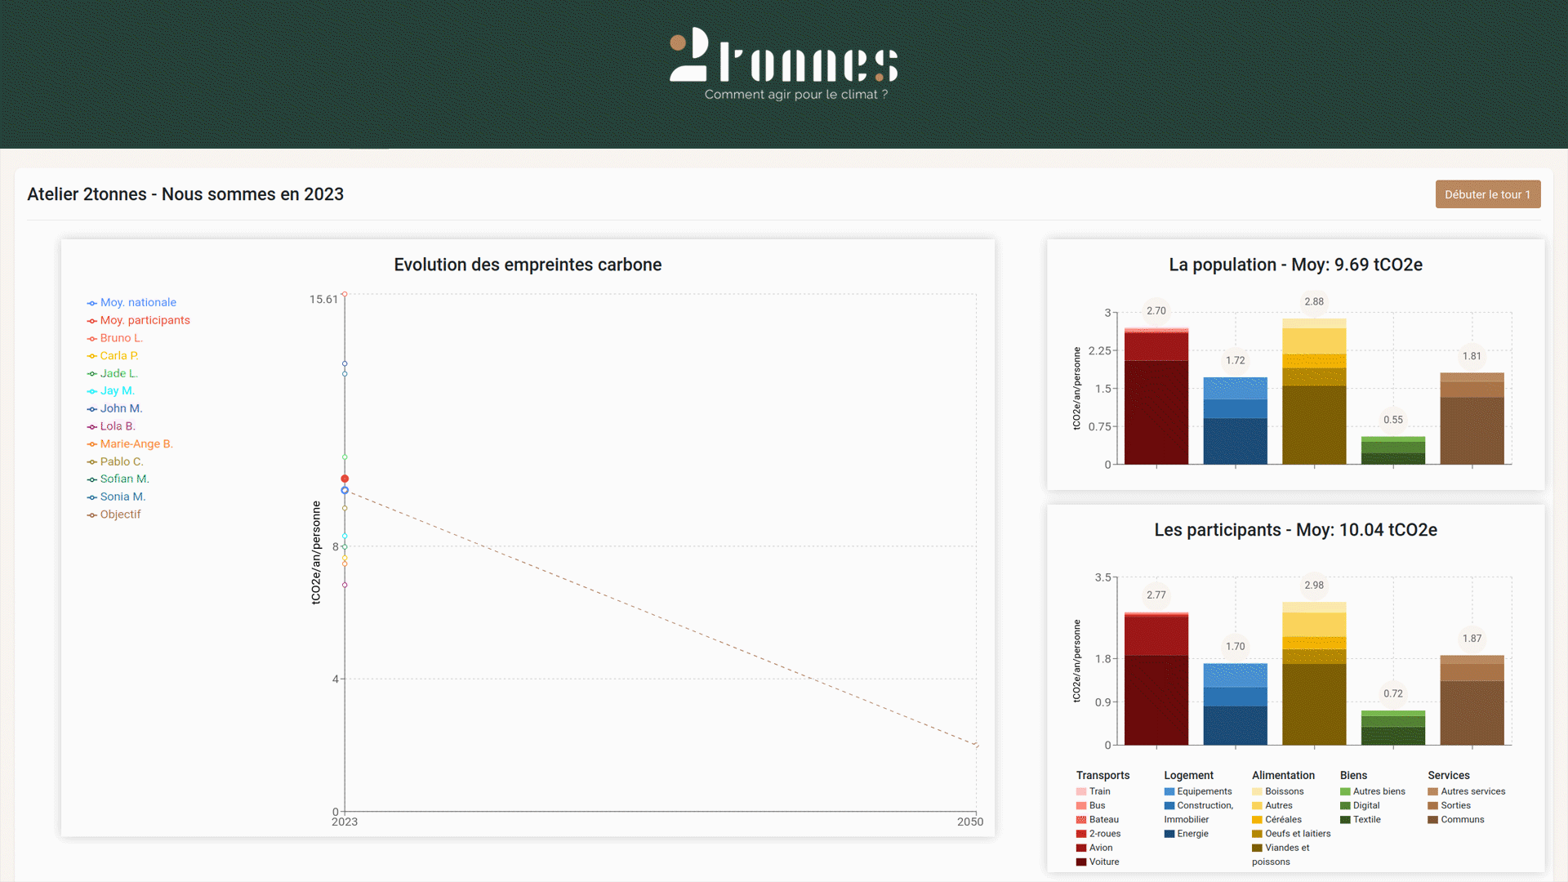
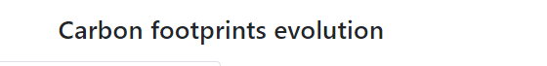

Slide 8
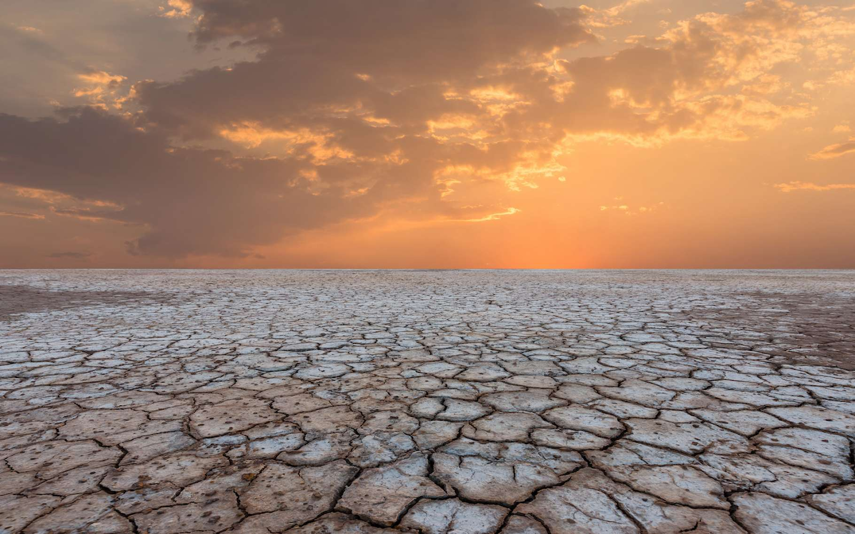
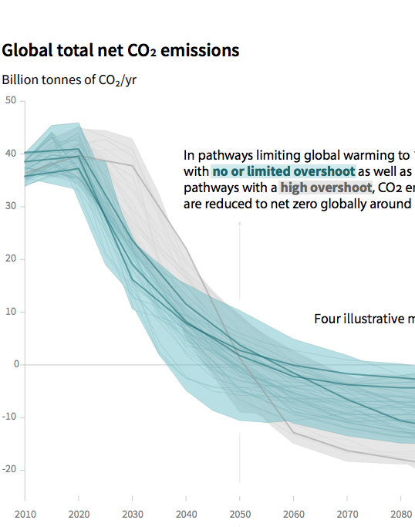
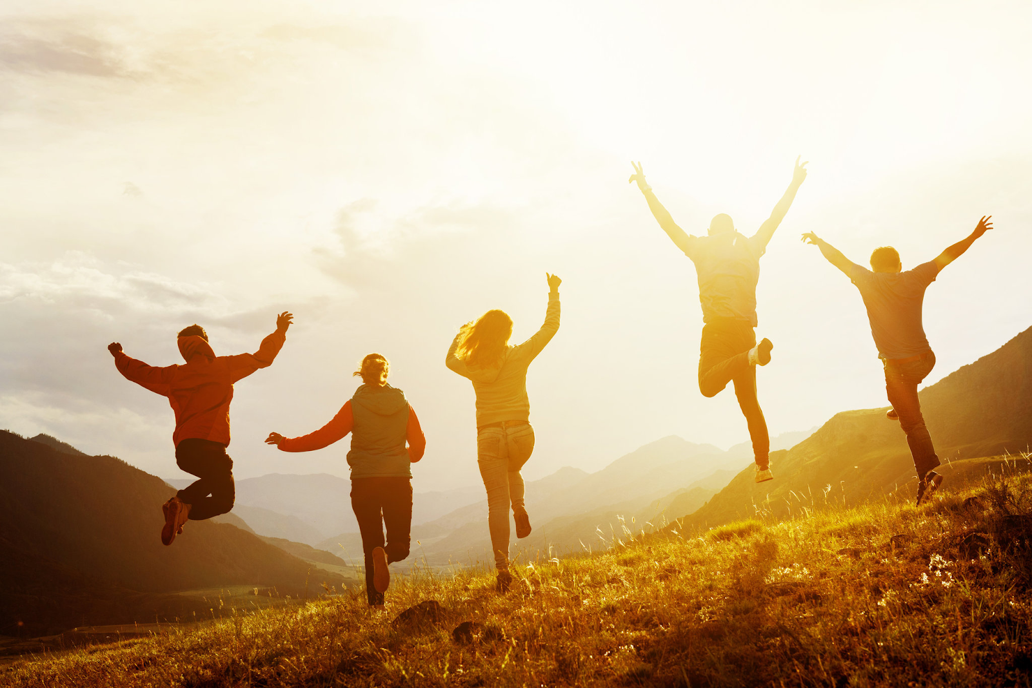
Low-carbon transition is...
Necessary
Possible
Desirable

Slide 9


















COMPANIES AND PUBLIC AUTHORITIES
References
and figures
Exponential momentum, 2tonnes journey in 2 years of launch:
Participants
+60 000
+4 000
Facilitators
in 21 countries
+62
Nationalities
among the participants

Slide 10
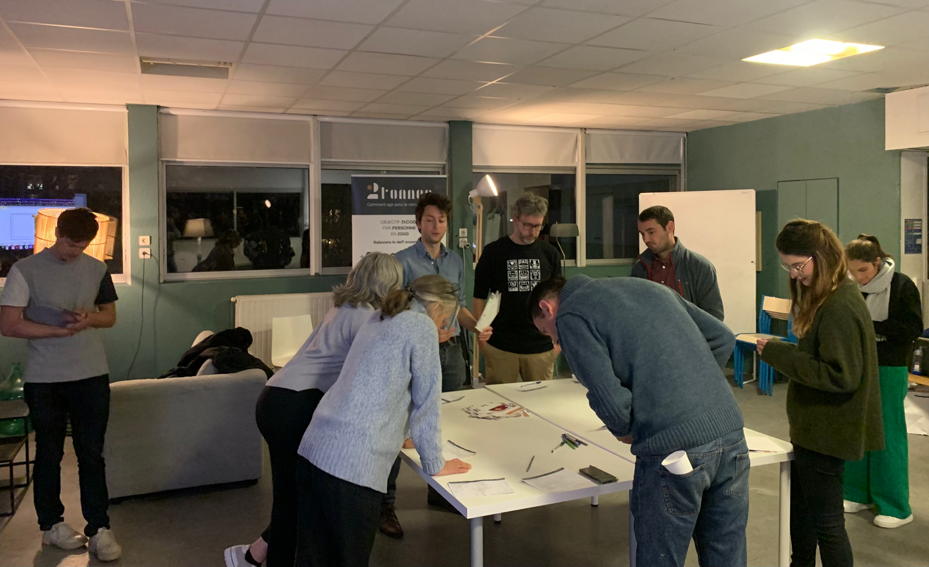
Thank you!
ありがとうございました。

